Slide 1

DECEASED ESTATES
ONLINE REPORTING

Slide 2
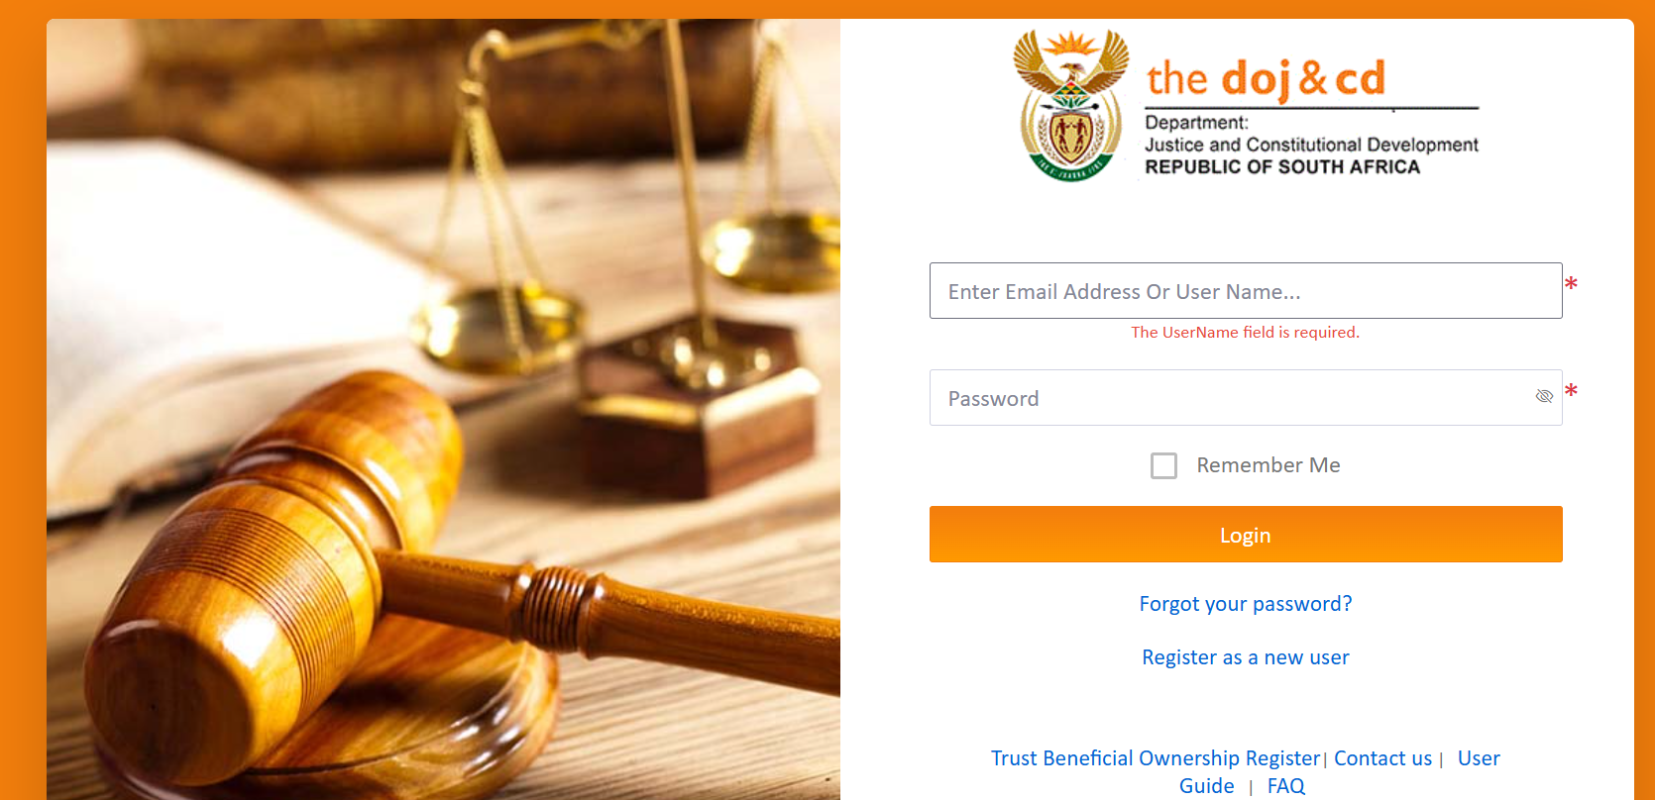
Where do you begin?
Deceased Estate must be reported on Department of Justice Online
Link: https://dojonline.justice.gov.za/Login?returnUrl
Log In / Register

Slide 3
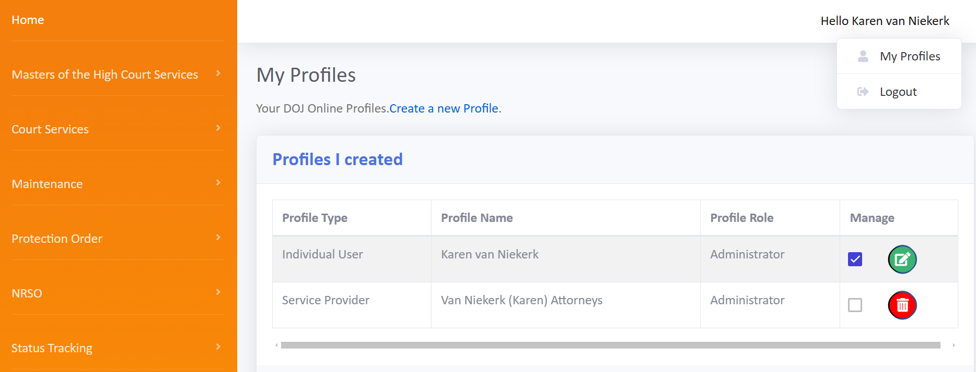
Home page Setup:
  Click on your name in the top right corner
  Click on My Profiles
  Create a new Profile (if needed)
Make sure you report a deceased estate on the correct profile:
    In your capacity as Executor = Individual User
    In your capacity as Agent of the Executor = Service Provider

Slide 4
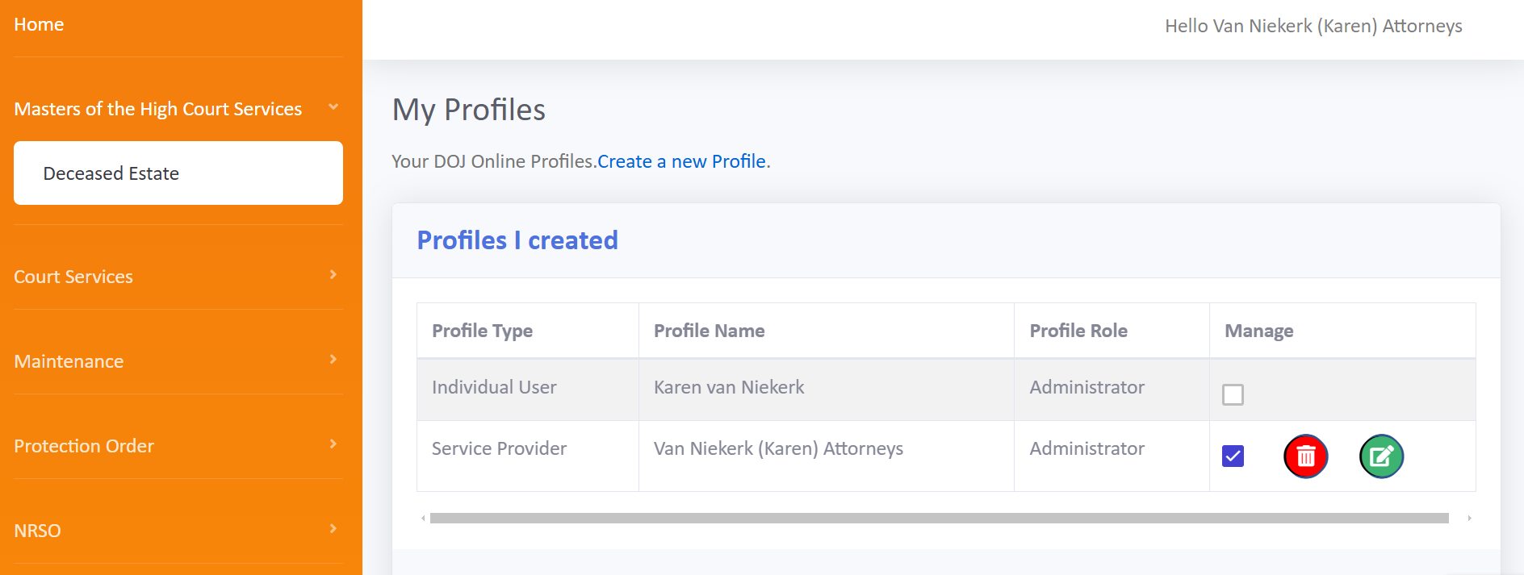
Report a new Deceased Estate
Click on Master of the High Court Services
Select Deceased Estate

Slide 5
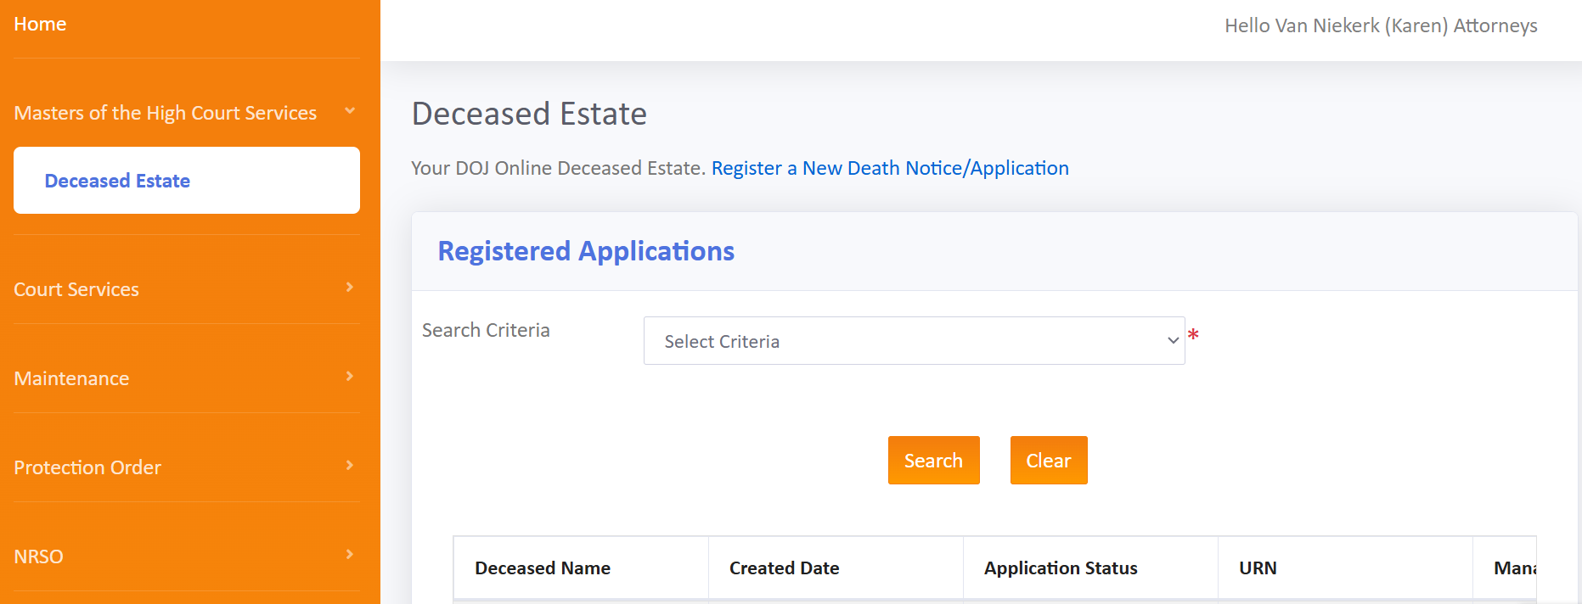
Click on register a New Death/Notice Application

Slide 6
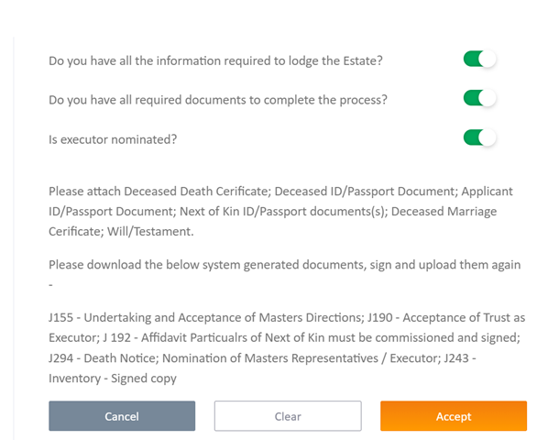
Complete the Deceased Estate Application Declaration and “Accept”

Slide 7
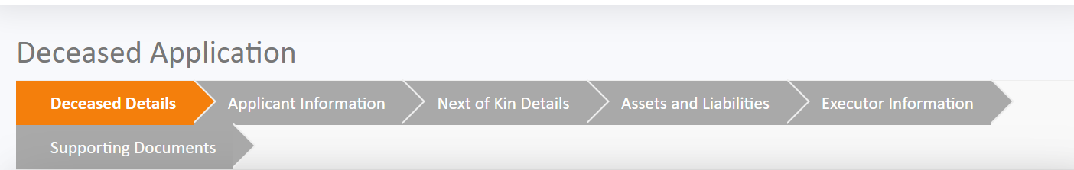
Deceased Application consists of 6 sections:
Complete each section’s details:
  Deceased Details
  Applicant Information
  Next-of-Kin Details
  Assets and Liabilities
  Executor Information
  Supporting Documents

Slide 8
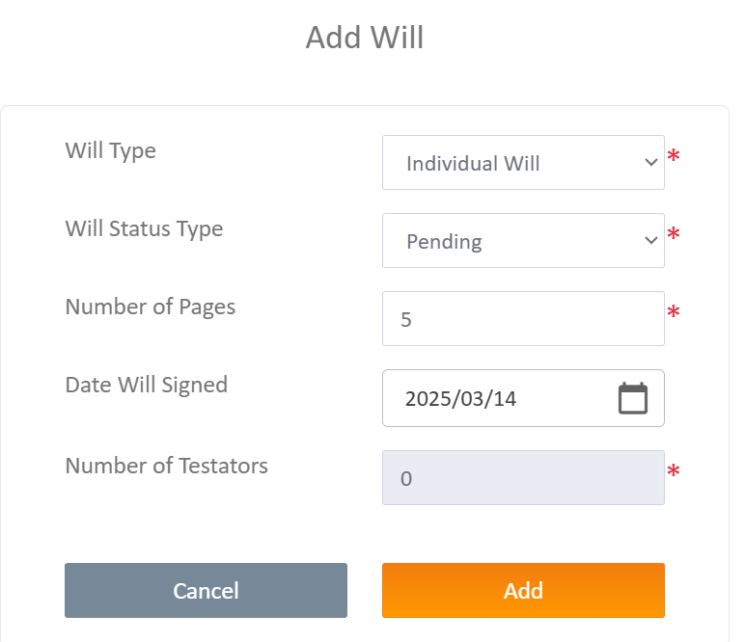
What should I look out for?
Deceased Details
  Similar to the details requested on the J294 Death Notice
  Click on “Add Will” (If a Will is available/applicable)
    Select “Pending” (Will still needs to be accepted by the Master of the High Court)

Slide 9
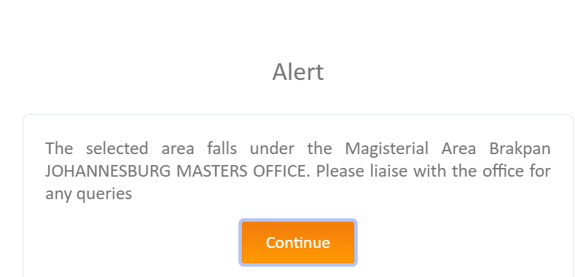
Click “Add Address”
  When the address is added, the system will inform you in which Master’s Jurisdiction the estate must be reported.

Slide 10
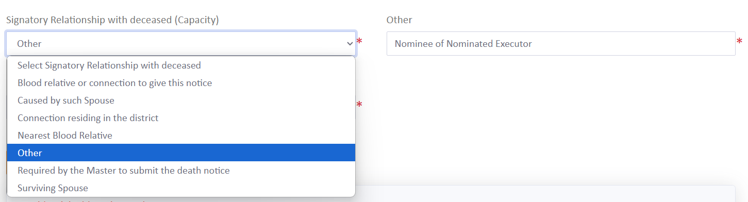
Applicant Information
  This is the person applying to the Master of the High Court
  Few “Capacity” options, if none is applicable, select “Other” and specify

Slide 11
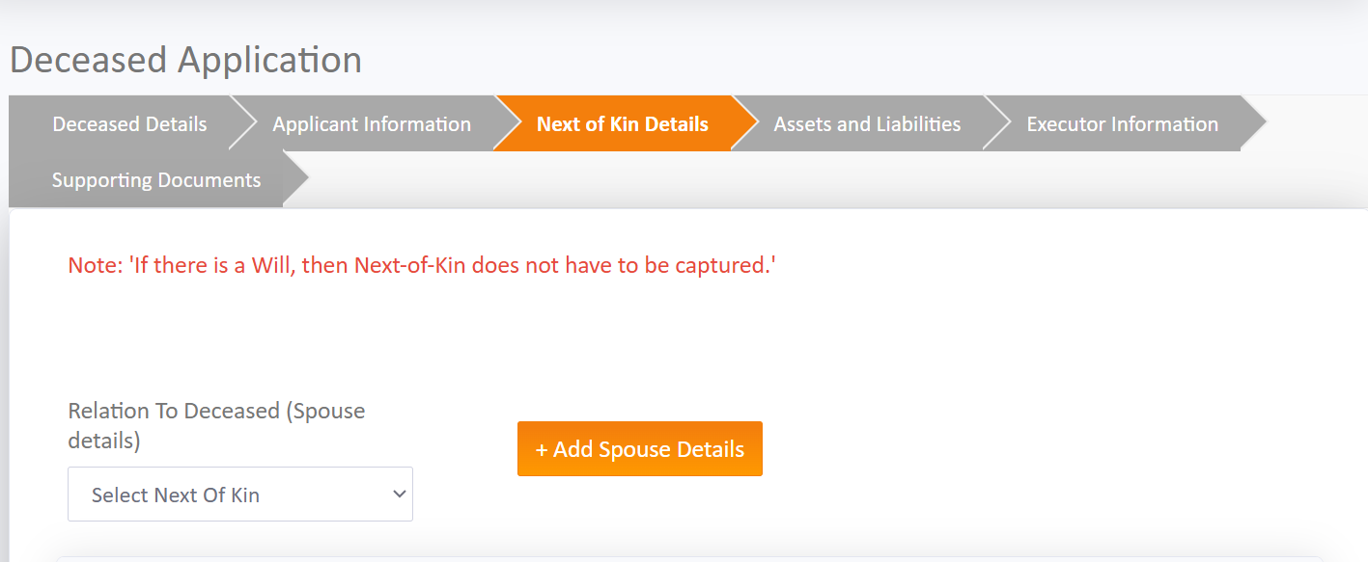
Next-of-Kin Details
Note: “If there is a Will, then Next-of-Kin does not have to be captured.”
However, if there is a surviving spouse:
  Select Next-of-Kin
    Husband
    Wife
    Life Partner
  Click “Add Spouse Details “

Slide 12
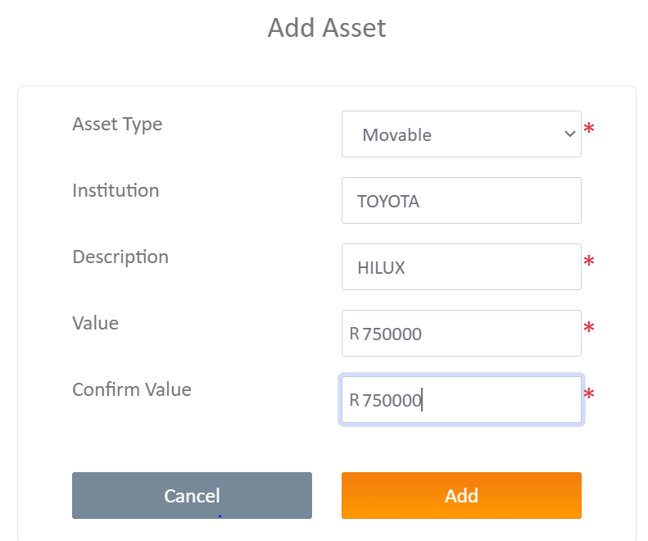
Assets and Liabilities
  Similar to the details requested on the J243 Inventory
  Add assets and liabilities by clicking on “Add Asset” and/or “Add Liability”

Slide 13
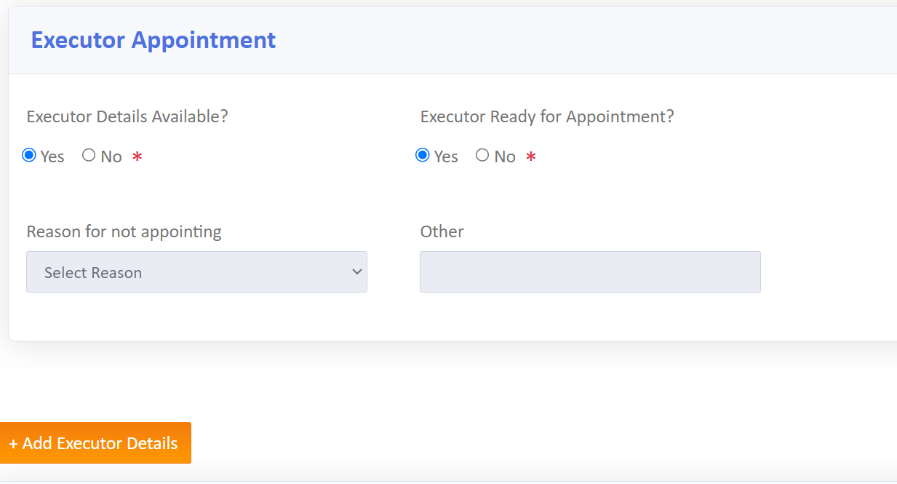
Executor Appointment
  Similar to the details requested on the J190 Acceptance of Trust as Executor / J155 Undertaking and Acceptance of Master’s Direction
  Click “Add Executor Details” (If there is more than one Executor, add each Executor separately)

Slide 14
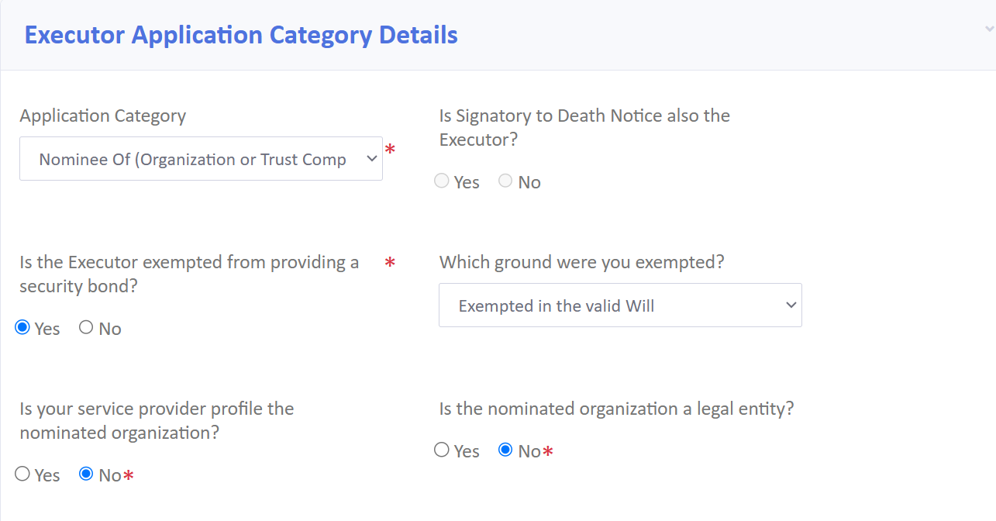
Add Address
Add Domicilium, Residential and Postal address
Add Correspondent Attorneys (if applicable)
Add Agent (if applicable)
Click “Add” in order to successfully add the Executor Details

Slide 15
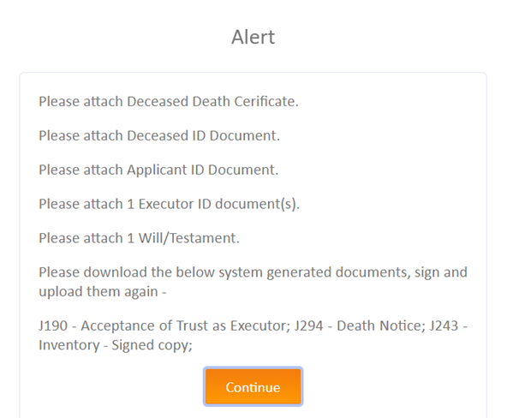
Supporting Documents
  Upload all the estate documents
  List will be provided, click “Continue”

Slide 16
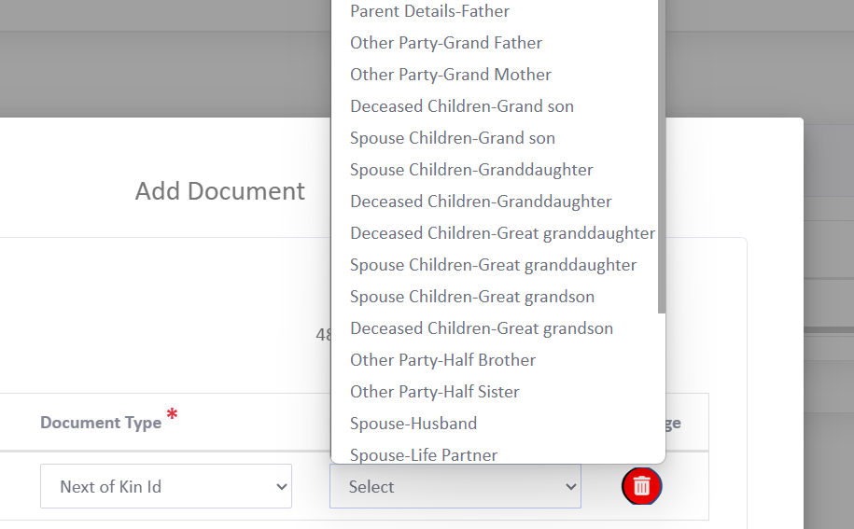
Please remember to upload the Deceased/Applicant and Executor’s ID-documents
Select the “Document Type”
Select the “Relationship to the Deceased” (if required)
For example:
If there is surviving spouse, select Next-Of-Kin ID and remember to specify the “Relationship to the Deceased”

Slide 17
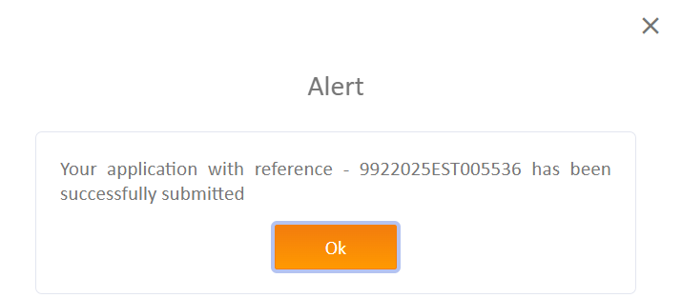
When all documents are uploaded:
Submit the Application
Accept the Disclaimer
Accept the Submission
The following “Alert” will appear on the screen, confirming the URN (Unique Reference Number)
It also confirms the estate number: 005536/2025

Slide 18
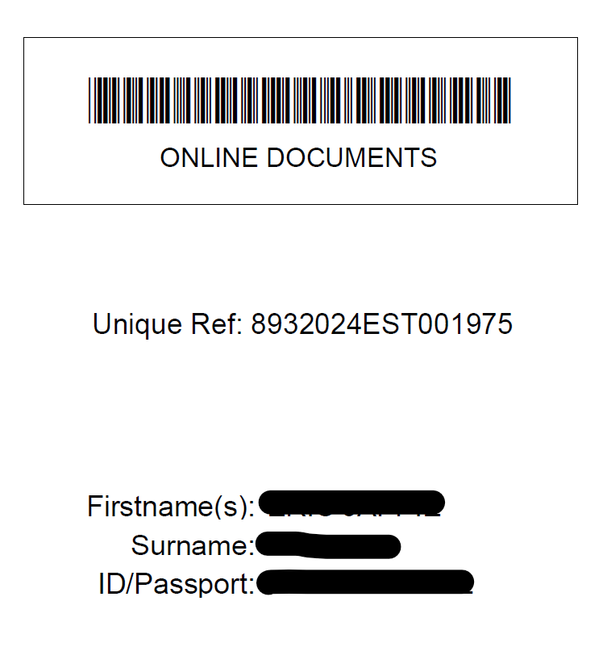
What is Next?
The Master of the High Court will email a Cover Page to be lodged with the Original Will and Reporting documents.

Slide 19
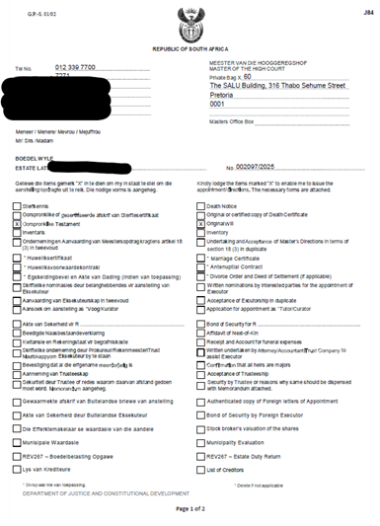
Should the Master of the High Court have any queries, a J84 Query Sheet will be issued and emailed:

Slide 20

Should the Master of the High Court be satisfied, a Letter of Executorship will be issued and emailed to the provided email address.

Slide 21


